Slide 1

BIKE RENTAL
PRESENTED BY:
PUJITH KUMAR
ARUN KUMAR
CHANDU
JENISHA
International Conference on Intelligent Computing and Communication (ICICC 24)-AUGUST 21-23, 2024
Notes:
1
jjjj

Slide 2
Abstract
With the increasing demand for sustainable and eco-friendly transportation, bike sharing systems have gained significant popularity in urban environments. These systems generate large volumes of data related to time, weather, and user behavior. This project focuses on analyzing bike rental data and predicting daily bike rental demand using environmental and seasonal factors. The dataset includes attributes such as temperature, humidity, wind speed, weather conditions, season, holidays, and working days. A complete exploratory data analysis is performed to identify usage patterns. Multiple machine learning models are developed and compared to obtain accurate predictions. The proposed system helps bike rental operators improve planning, resource utilization, and overall service quality.
IEEE - International Conference on Vision Towards Emerging Trends in Communication and Networking (ViTECoN’23)
Notes:
2

Slide 3
Introduction
Bike sharing systems are an important component of smart city transportation solutions. Unlike traditional transport services, bike rental systems provide detailed and structured data that captures mobility behavior across different environmental conditions. Understanding how factors such as weather, season, and temperature affect bike usage is essential for effective system management. Accurate demand prediction helps avoid issues like bike shortages and over-crowding. This project applies data analytics and machine learning techniques to predict daily bike rental counts, enabling data-driven decision-making and improved operational efficiency.
IEEE - International Conference on Vision Towards Emerging Trends in Communication and Networking (ViTECoN’23)
Notes:
3

Slide 4
Problem Identification
Bike rental demand is highly dynamic and influenced by multiple external factors such as weather conditions, seasonal changes, working days, and holidays. Inaccurate demand forecasting can result in operational inefficiencies, including insufficient bike availability during peak demand or excess bikes during low usage periods. Traditional statistical methods are limited in capturing complex non-linear relationships between these variables. Therefore, the main problem is to develop an accurate and reliable prediction model that can estimate daily bike rental demand based on environmental and seasonal factors.
IEEE - International Conference on Vision Towards Emerging Trends in Communication and Networking (ViTECoN’23)
Notes:
4

Slide 5
Objective
The primary objective of this project is to predict daily bike rental counts using environmental and seasonal attributes. Additional objectives include performing detailed exploratory data analysis to understand rental patterns, identifying key features that influence demand, preprocessing and transforming the dataset for machine learning, comparing multiple predictive models, and selecting the best-performing model. The project also aims to support better planning and decision-making for bike rental system operators.
IEEE - International Conference on Vision Towards Emerging Trends in Communication and Networking (ViTECoN’23)
Notes:
5

Slide 6
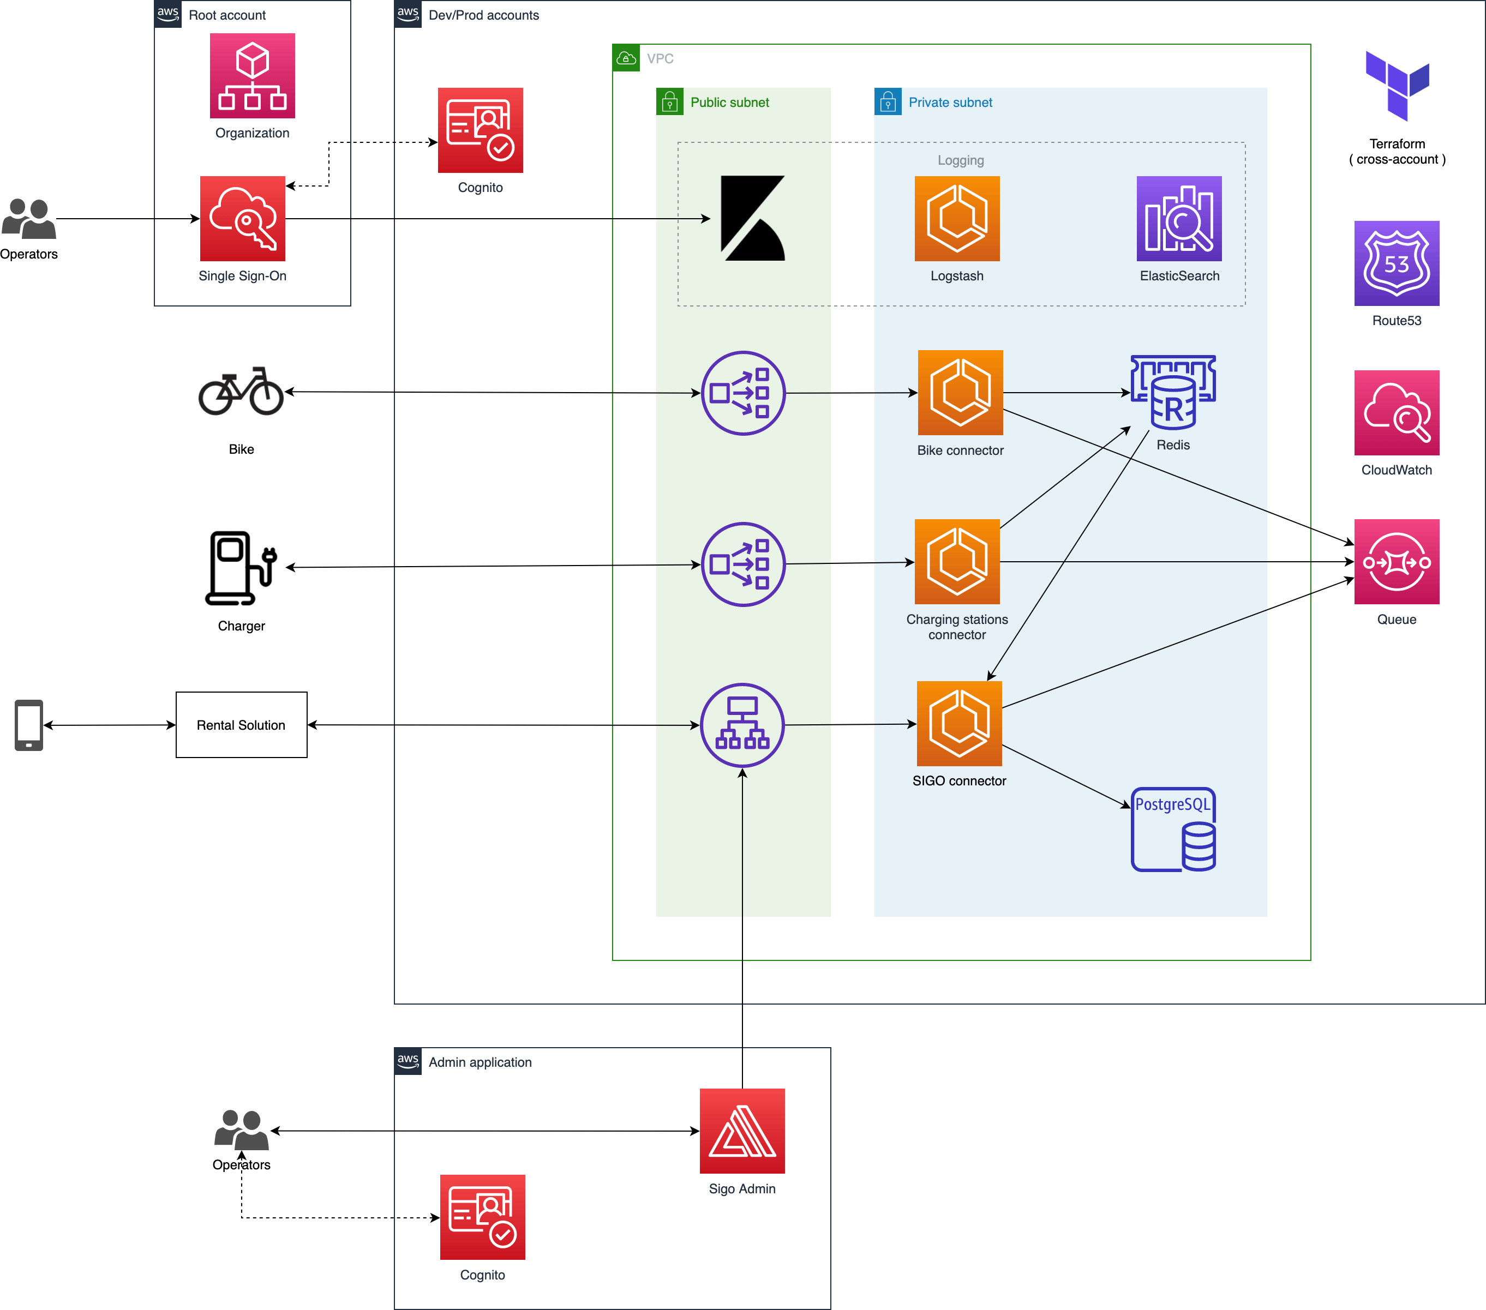
System Architecture
IEEE - International Conference on Vision Towards Emerging Trends in Communication and Networking (ViTECoN’23)
Notes:
6

Slide 7
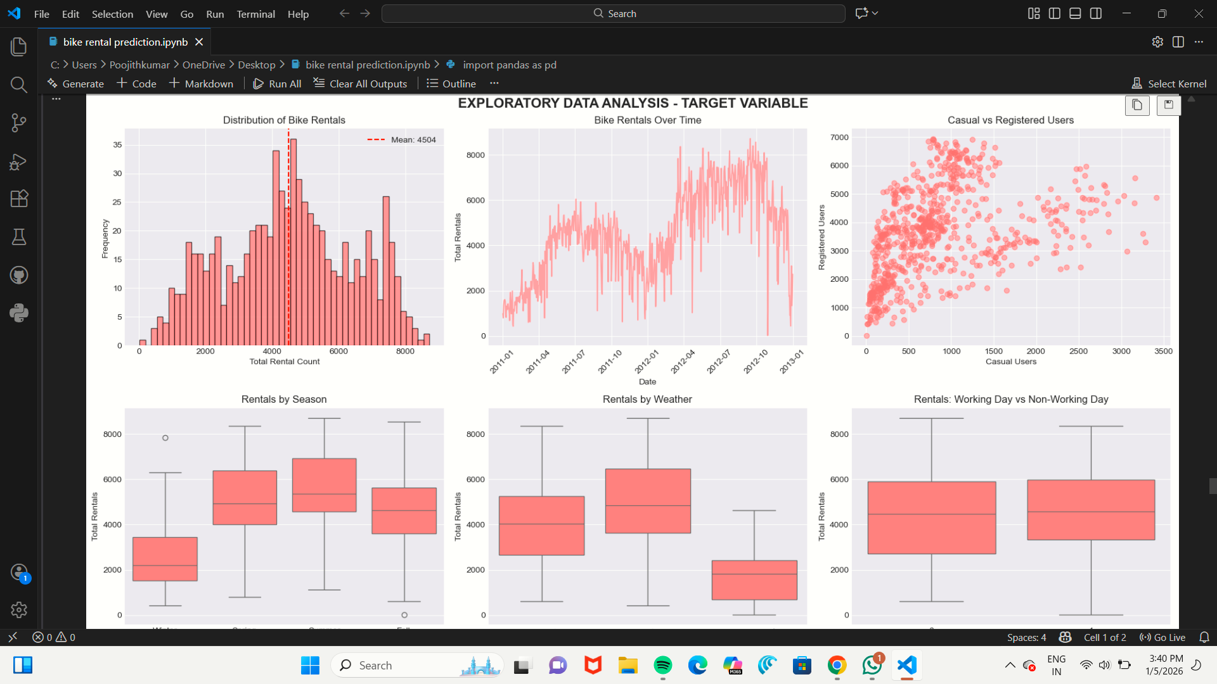
Visualizations
IEEE - International Conference on Vision Towards Emerging Trends in Communication and Networking (ViTECoN’23)
Notes:
7

Slide 8
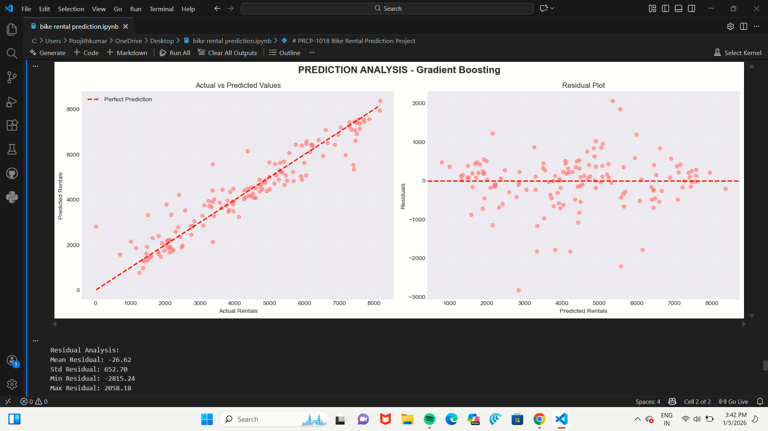
Visualizations
IEEE - International Conference on Vision Towards Emerging Trends in Communication and Networking (ViTECoN’23)
Notes:
8

Slide 9
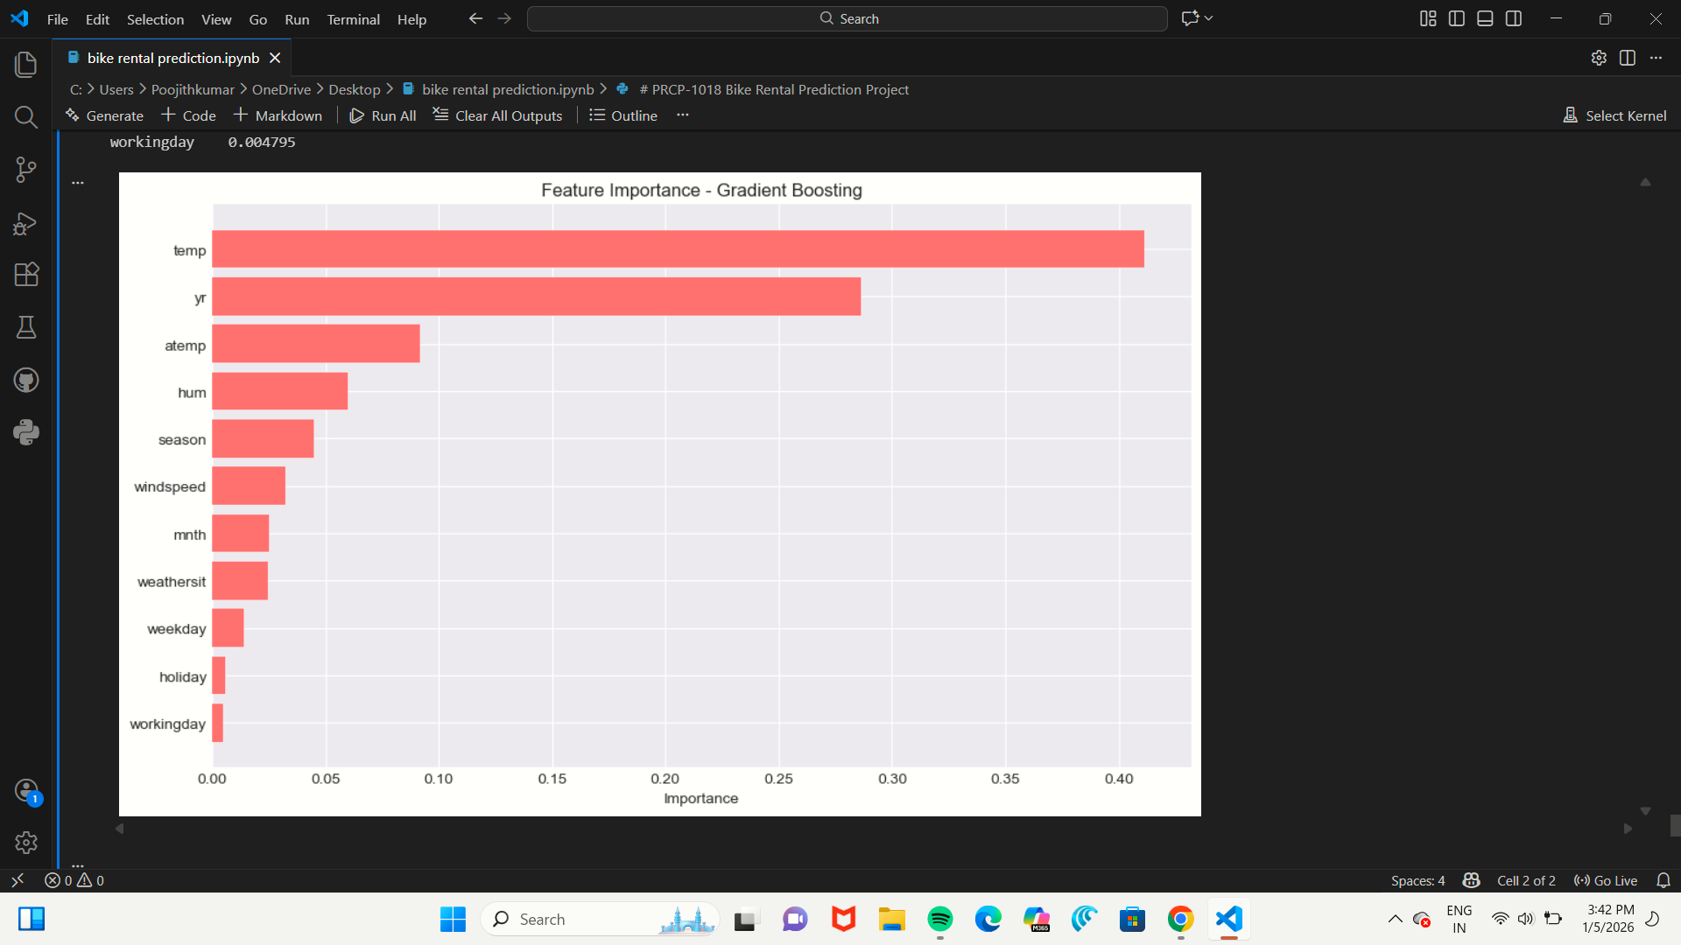
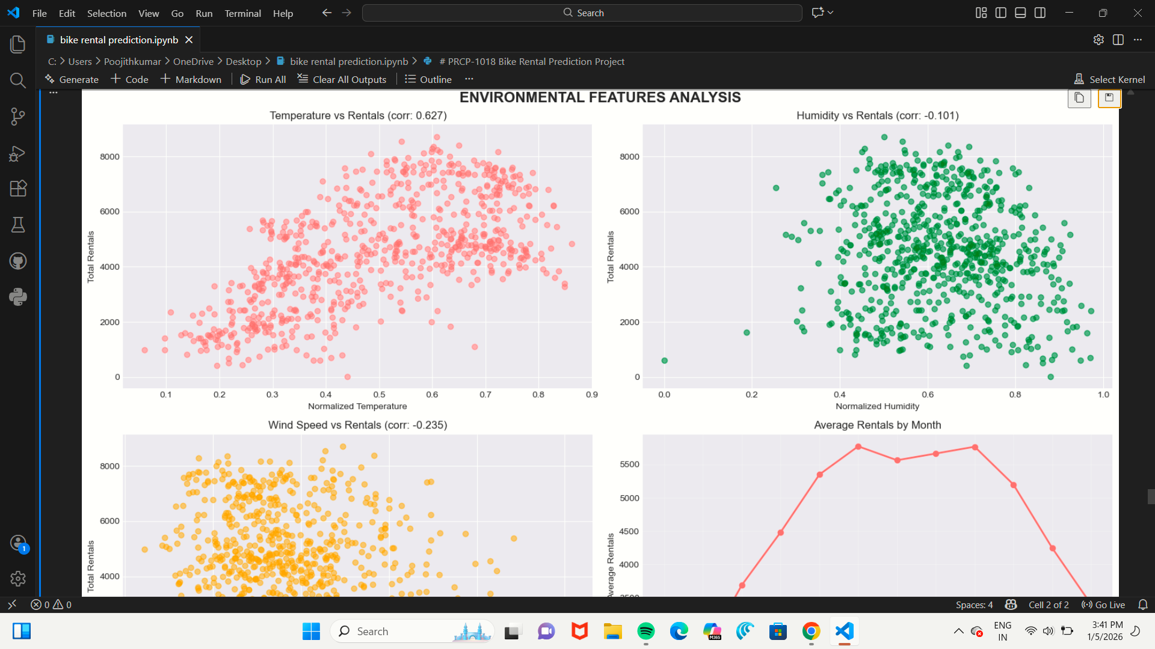
Visualizations
IEEE - International Conference on Vision Towards Emerging Trends in Communication and Networking (ViTECoN’23)
Notes:
9

Slide 10
Key Insights
Bike rental demand increases significantly with higher temperatures and pleasant weather conditions.
Strong seasonal patterns are observed, with peak demand during summer and fall and lower usage in winter.
Adverse weather conditions such as rain and snow lead to a noticeable decline in bike rentals.
Rentals are consistently higher on working days, indicating frequent use for daily commuting.
The demand patterns show non-linear relationships, making machine learning models suitable for accurate prediction.
IEEE - International Conference on Vision Towards Emerging Trends in Communication and Networking (ViTECoN’23)
Notes:
10

Slide 11
Related work
Several studies have explored bike rental demand prediction using data analytics and machine learning techniques. Earlier research used linear regression and time-series analysis to model demand patterns. Recent studies have applied advanced algorithms such as decision trees, random forests, gradient boosting, and neural networks to capture complex relationships between weather, seasonality, and bike usage. Most studies highlight temperature and weather conditions as major influencing factors. This project builds upon previous work by conducting comprehensive model comparison and focusing on daily demand prediction.
IEEE - International Conference on Vision Towards Emerging Trends in Communication and Networking (ViTECoN’23)
Notes:
11

Slide 12
Proposed Methodology
The proposed methodology begins with importing and understanding the bike rental dataset. Data preprocessing includes handling categorical variables such as season and weather conditions and scaling numerical attributes like temperature and humidity. Exploratory data analysis is conducted to visualize trends and relationships between features and rental counts. Feature selection is performed to identify the most influential variables. The dataset is split into training and testing sets. Multiple regression models are trained and evaluated using metrics such as Root Mean Square Error (RMSE) and R² score. The best model is selected for final prediction.
IEEE - International Conference on Vision Towards Emerging Trends in Communication and Networking (ViTECoN’23)
Notes:
12

Slide 13
Results and Discussion
The results indicate that environmental and seasonal factors have a significant impact on bike rental demand. Higher temperatures and favorable weather conditions are associated with increased rentals, while adverse weather conditions lead to reduced usage. Model comparison shows that advanced machine learning models outperform baseline regression models in terms of prediction accuracy. The selected model provides reliable predictions with lower error values. These results demonstrate the effectiveness of machine learning techniques for demand forecasting in bike sharing systems.
International Conference on Intelligent Computing and Communication (ICICC 24)-AUGUST 21-23, 2024
Notes:
13

Slide 14
Conclusion
This project effectively applies data analysis and machine learning techniques to predict daily bike rental demand. Exploratory analysis shows that temperature, weather conditions, seasonality, and working days significantly influence bike usage patterns. Advanced machine learning models outperform traditional regression approaches by capturing non-linear relationships in the data. Accurate demand prediction can help bike rental operators optimize bike availability, reduce operational costs, and improve service efficiency. The system can be further enhanced by integrating real-time weather data for smarter decision-making in urban mobility solutions.
International Conference on Intelligent Computing and Communication (ICICC 24)-AUGUST 21-23, 2024
Notes:
14

